Slide 1
Machine Learning Methods and Tools
Elena Zennaro, Wolfgang Ecker, Lorenzo Servadei

Slide 2
Machine Learning Algorithms
Elena Zennaro, Wolfgang Ecker, Lorenzo Servadei

Slide 3
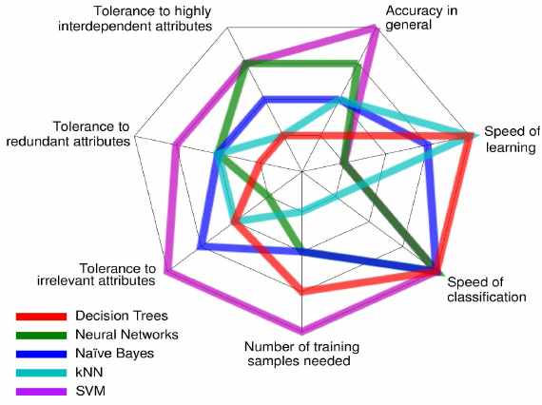
Introduction to Machine Learning Algorithms

Slide 4
Table of Contents
Machine Learning Algorithms – an Overview
The Data Driven Approach
K-Nearest Neighbors
Linear Classifier
Loss Functions
Decision Trees and Random Forrest

Slide 5
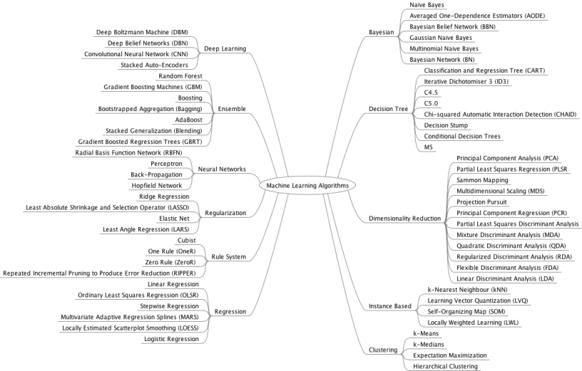
Machine Learning Algorithms – an Overview

Slide 6
Machine Learning Algorithms – an Overview
Parametric Learning Algorithms
Non-parametric Learning Algorithms
Logistic Regression
Linear Classifier
Perceptron
Etc.
KNNs
Decision Trees
Random Forest
Etc.

Slide 7
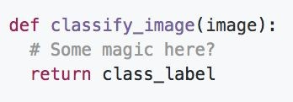
Problem of hard coded classification
Unlike e.g. sorting a list of numbers,
no obvious way to hard-code the algorithm for recognizing a cat, or other classes.

Slide 8
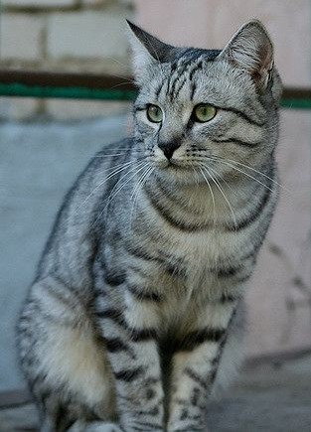
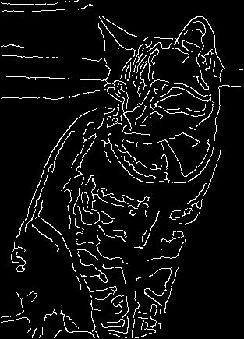
Edges based method?
Find edges
Find corners
John Canny, “A Computational Approach to Edge Detection”, IEEE TPAMI 1986
?

Slide 9
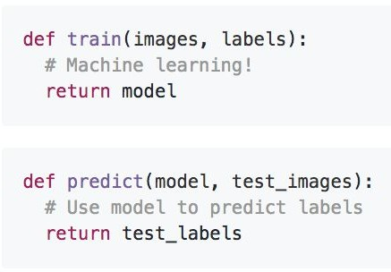
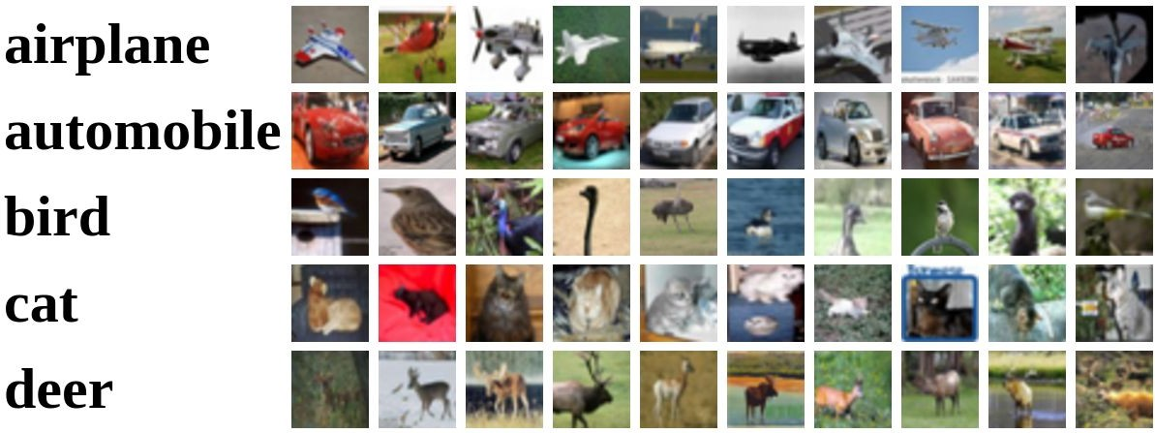
A possible Approach
Collect a dataset of images and labels
Use Machine Learning to train a classifier
Evaluate the classifier on new images
Example training set

Slide 10
A possible Approach
Memorize all data and labels
Predict the label of the most similar training image

Slide 11
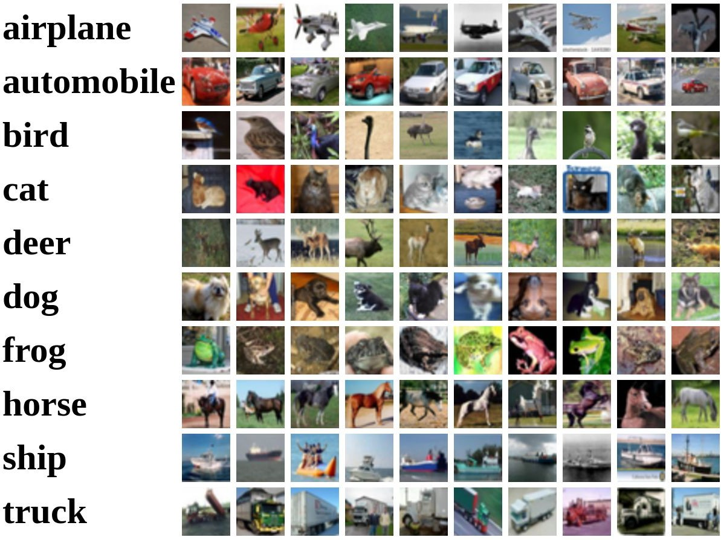
Example Dataset: CIFAR10
10 classes
50,000 training images
10,000 testing images
Alex Krizhevsky, “Learning Multiple Layers of Features from Tiny Images”, Technical Report, 2009.

Slide 12
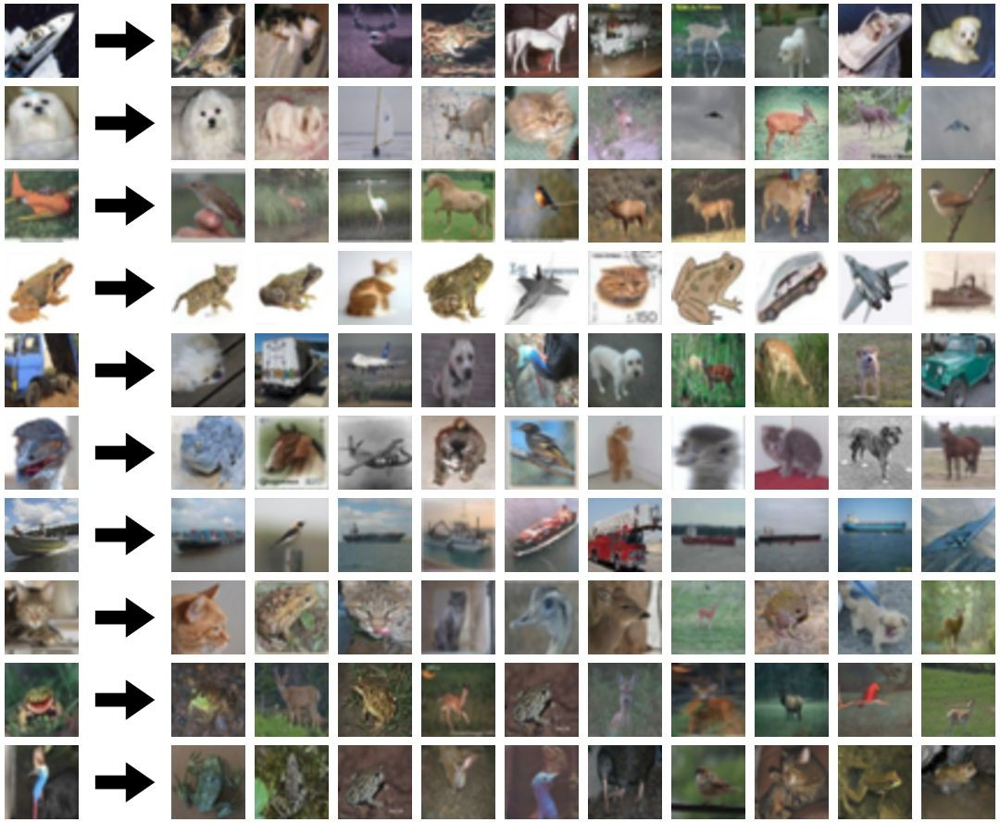
Alex Krizhevsky, “Learning Multiple Layers of Features from Tiny Images”, Technical Report, 2009.

Slide 13
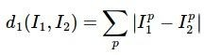
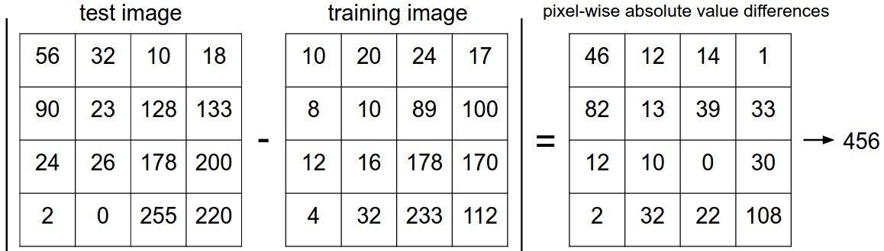
L1 Distance
L1 distance:

Slide 14
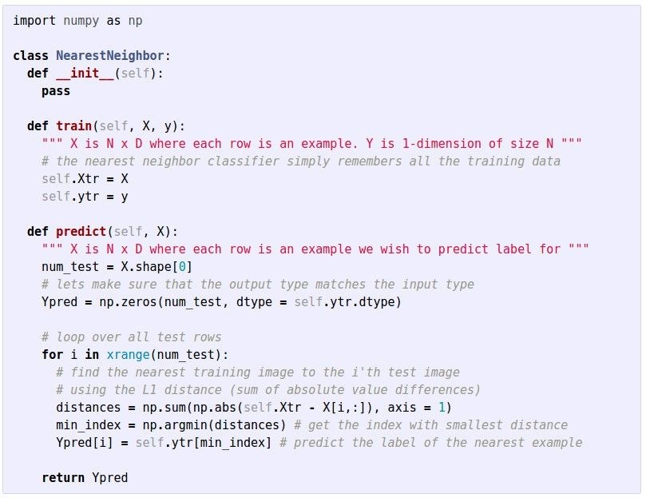
Code implementation, using Numpy
Nearest Neighbor classifier
Lecture 2 -

Slide 15
Code implementation, using Numpy
Nearest Neighbor classifier
Memorize training data
Lecture 2 -

Slide 16
Nearest Neighbor classifier
Code implementation, using Numpy
For each test image: Find closest train image
Predict label of nearest image
Lecture 2 -

Slide 17
Code implementation, using Numpy
Nearest Neighbor classifier
Q: With N examples, how fast are training and prediction?
Lecture 2 -

Slide 18
Code implementation, using Numpy
Nearest Neighbor classifier
Q: With N examples, how fast are training and prediction?
A: Train O(1), predict O(N)
Lecture 2 -

Slide 19
Code implementation, using Numpy
Nearest Neighbor classifier
Q: With N examples, how fast are training and prediction?
A: Train O(1), predict O(N)
This is bad: we want classifiers that are fast at prediction; slow for training is ok
Lecture 2 -

Slide 20
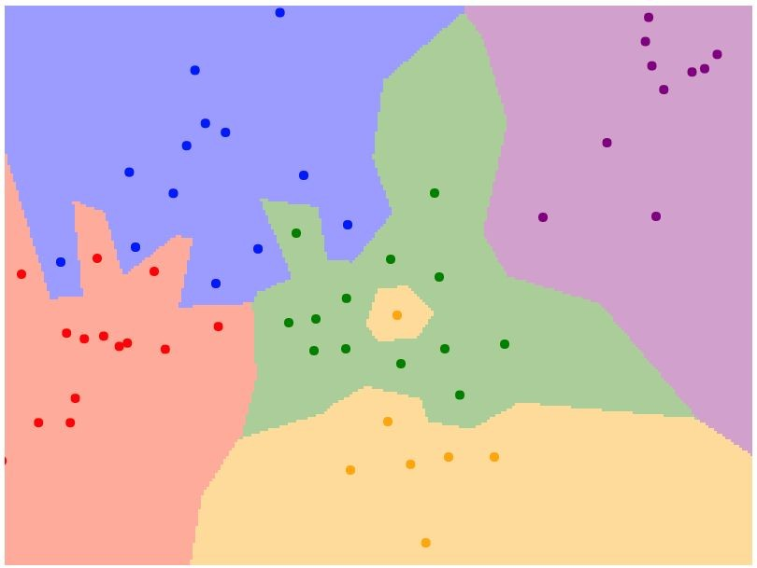
K-Nearest Neighbors
Lecture 2 -

Slide 21
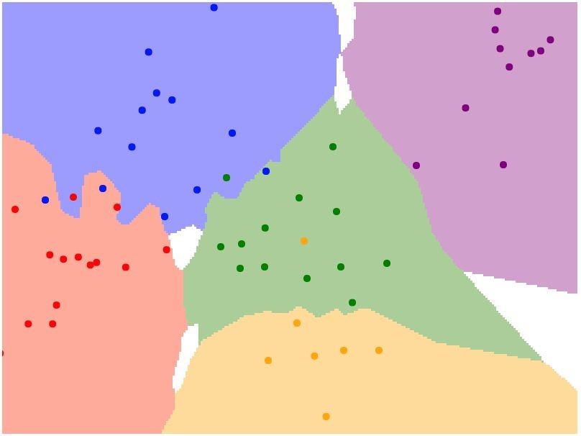
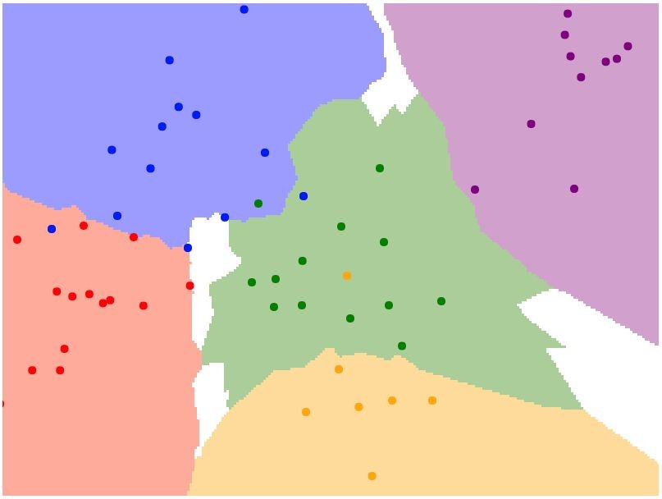
K-Nearest Neighbors
Instead of copying label from nearest neighbor, take majority vote from K closest points
K = 1
K = 3
K = 5
Lecture 2 -

Slide 22
What does it looks like?
Lecture 2 -

Slide 23
What does it looks like?
Lecture 2 -

Slide 24
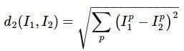
K-Nearest Neighbors: Distance Metric
L1 (Manhattan) distance L2 (Euclidean) distance
Lecture 2 -
Notes:
dimension of a data point is numeric, the general form is called the Minkowski distance

Slide 25
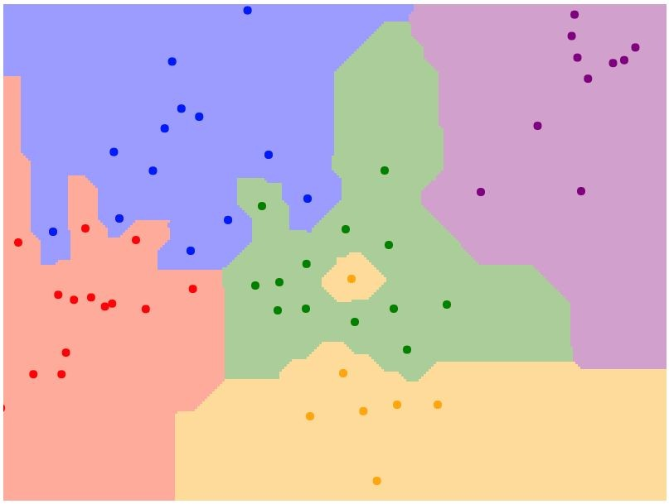
K-Nearest Neighbors: Distance Metric
L1 (Manhattan) distance L2 (Euclidean) distance
K = 1
K = 1
Lecture 2 -

Slide 26
K-Nearest Neighbors: Demo
http://vision.stanford.edu/teaching/cs231n-demos/knn/

Slide 27
K-Nearest Neighbors: Hyperparameters
What is the best value of k to use? What is the best distance to use?
These are hyperparameters: choices about the algorithm that we set rather than learn
Very problem-dependent.

Slide 28
Searching for Hyperparameters
Idea #1: Choose hyperparameters that work best on the data
Your Dataset

Slide 29
Searching for Hyperparameters
Idea #1: Choose hyperparameters that work best on the data
BAD: always works perfectly on training data
Your Dataset

Slide 30
Searching for Hyperparameters
Idea #1: Choose hyperparameters that work best on the data
BAD: always works perfectly on training data
Your Dataset
Idea #2: Split data into train and test, choose hyperparameters that work best on test data
train
test

Slide 31
Searching for Hyperparameters
Idea #1: Choose hyperparameters that work best on the data
BAD: always works perfectly on training data
Your Dataset
Idea #2: Split data into train and test, choose hyperparameters that work best on test data
train
test
BAD: No idea how algorithm will perform on new data

Slide 32
Searching for Hyperparameters
Idea #3: Split data into train, val, and test; choose hyperparameters on val and evaluate on test
train | validation | test

Slide 33
Searching for Hyperparameters
Idea #4: Cross-Validation: Split data into folds, try each fold as validation and average the results
fold 1 | fold 2 | fold 3 | fold 4 | fold 5 | test
fold 1 | fold 2 | fold 3 | fold 4 | fold 5 | test
fold 1 | fold 2 | fold 3 | fold 4 | fold 5 | test
Useful for small datasets, but not used too frequently in deep learning

Slide 34
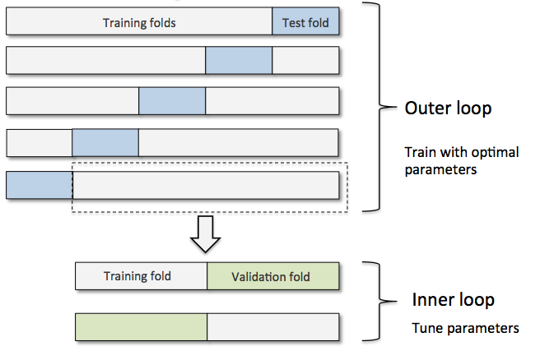
Searching for Hyperparameters
Idea #5: Nested Cross-Validation: Two Loops, for model selection and evaluation

Slide 35
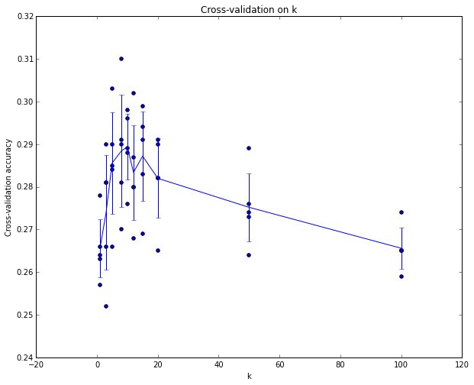
Searching for Hyperparameters
Example of
5-fold cross-validation
for the value of k.
Each point: single outcome.

Slide 36
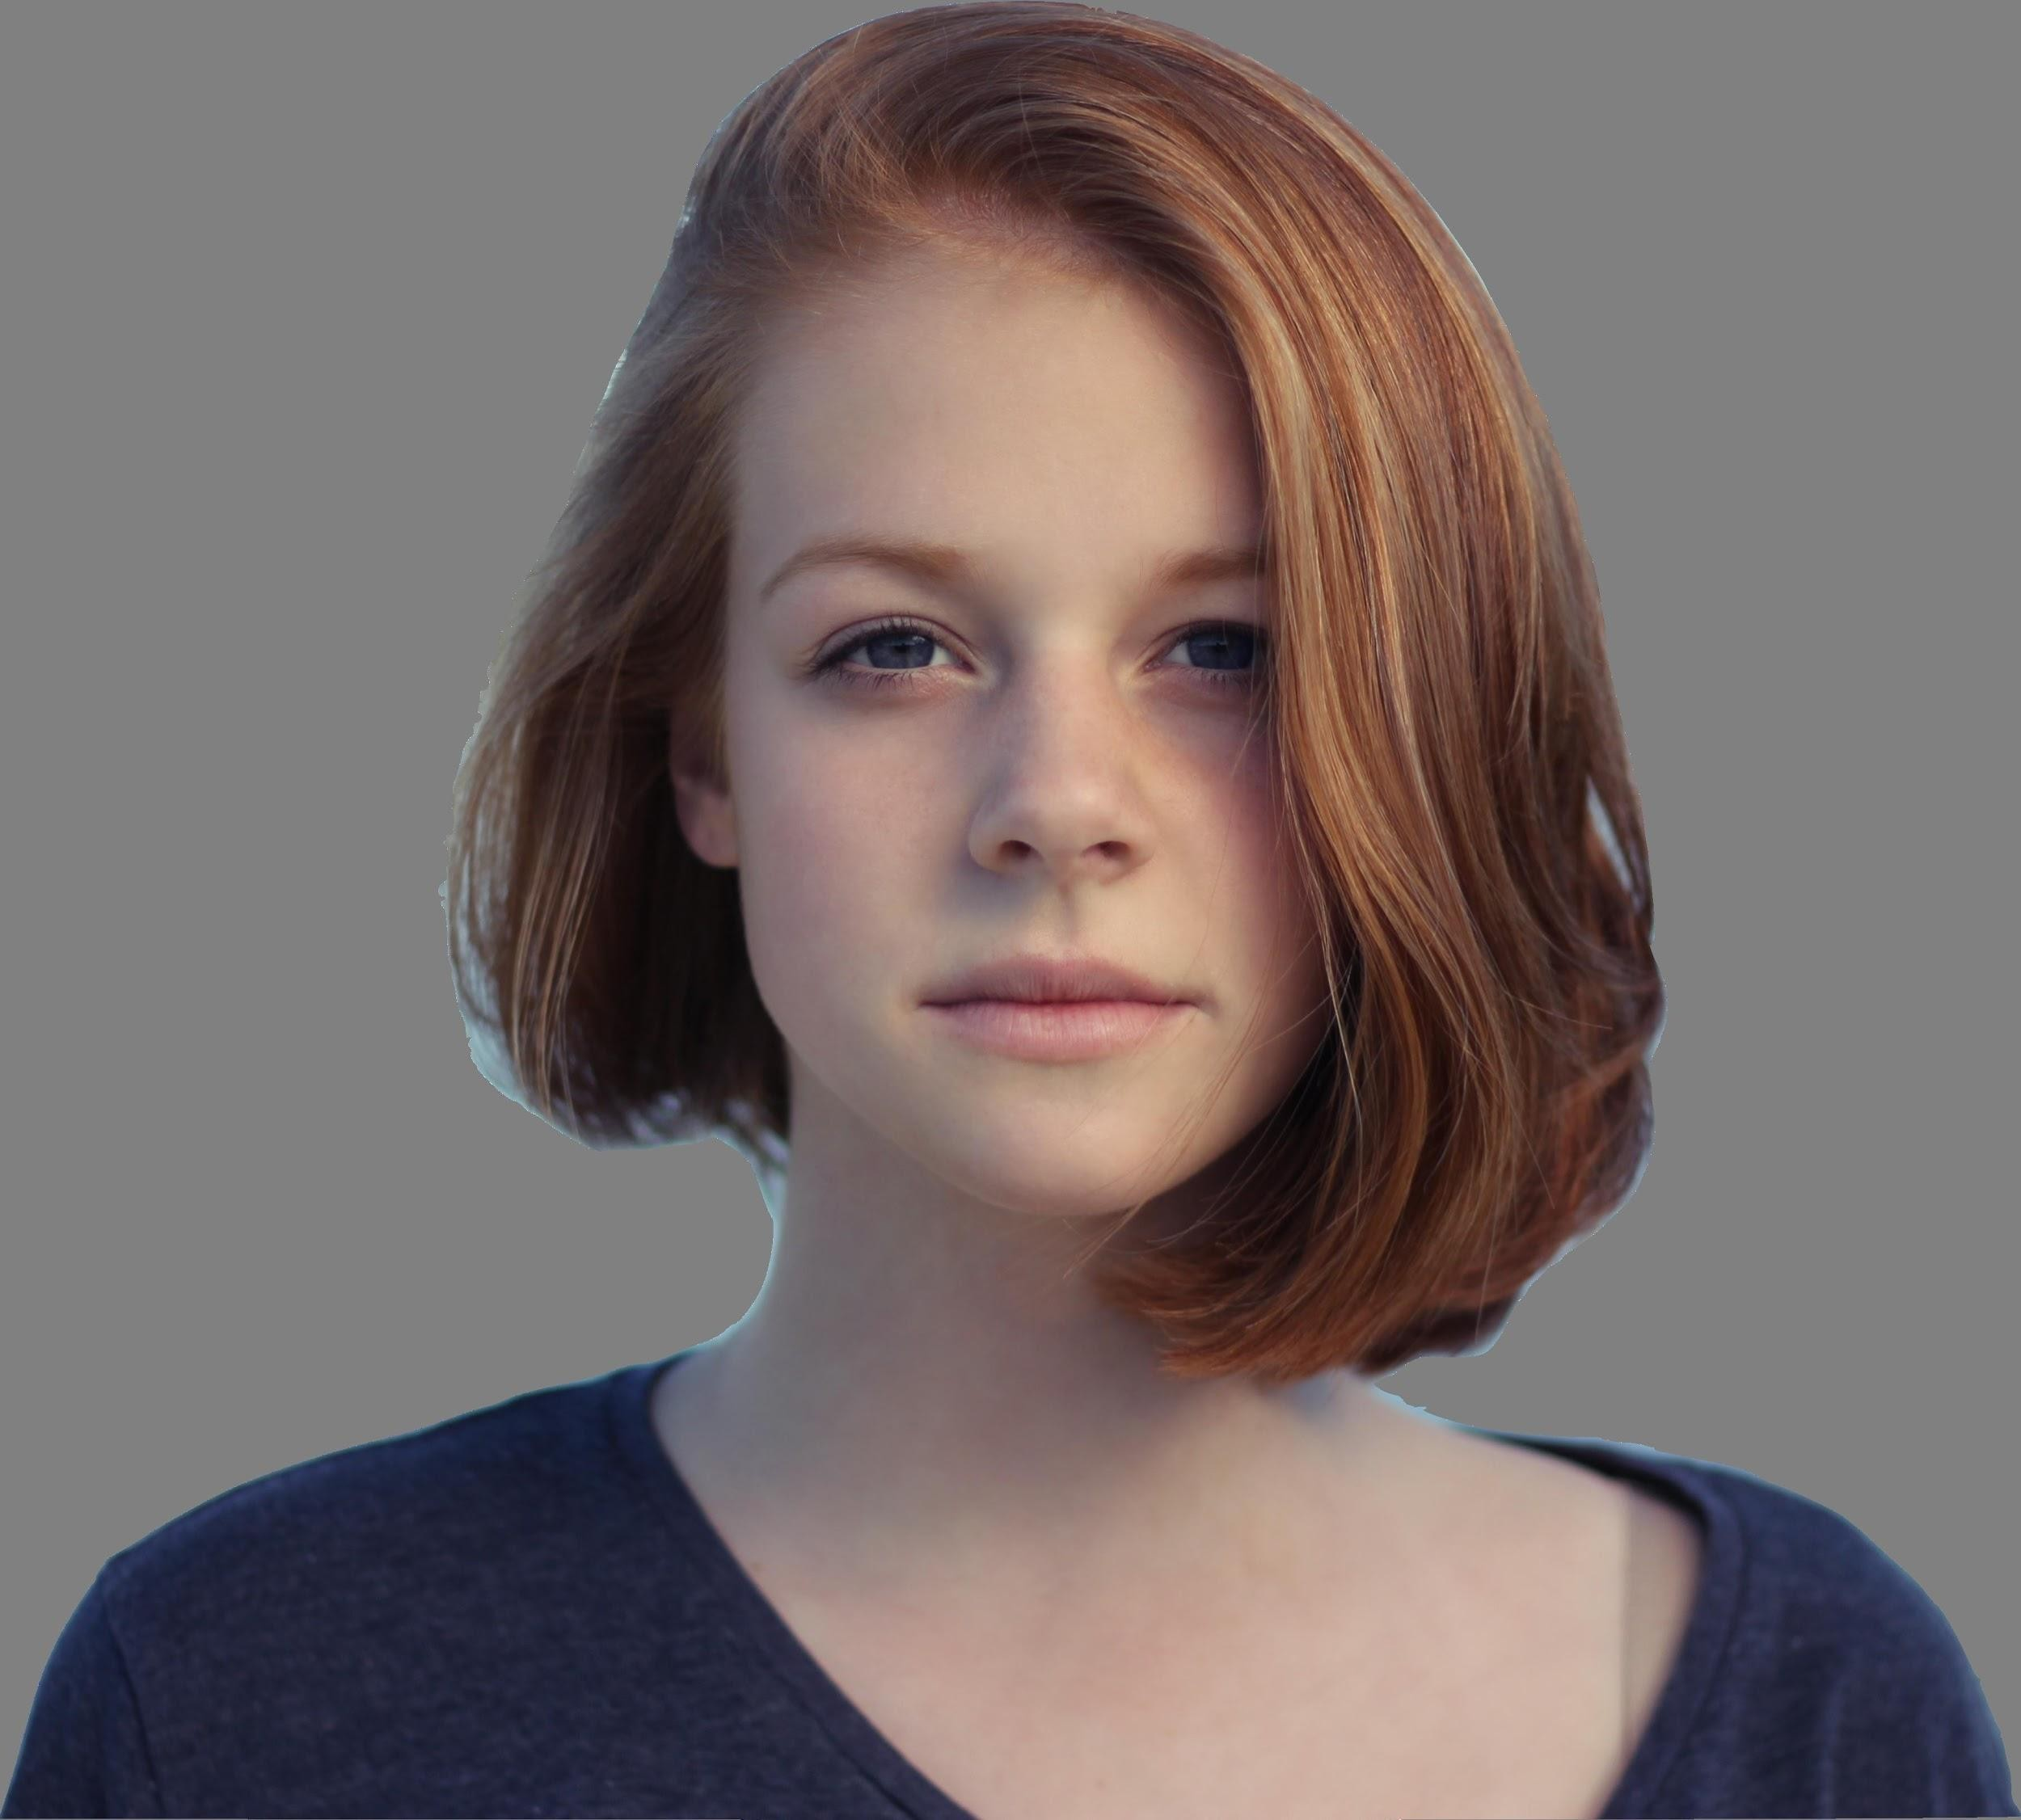
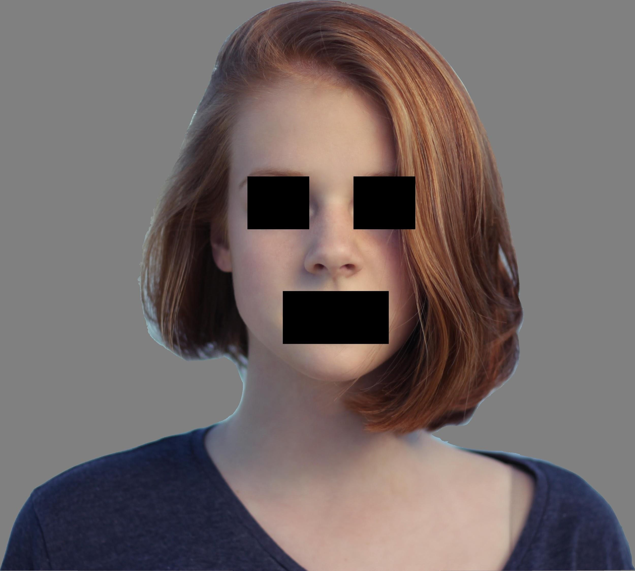
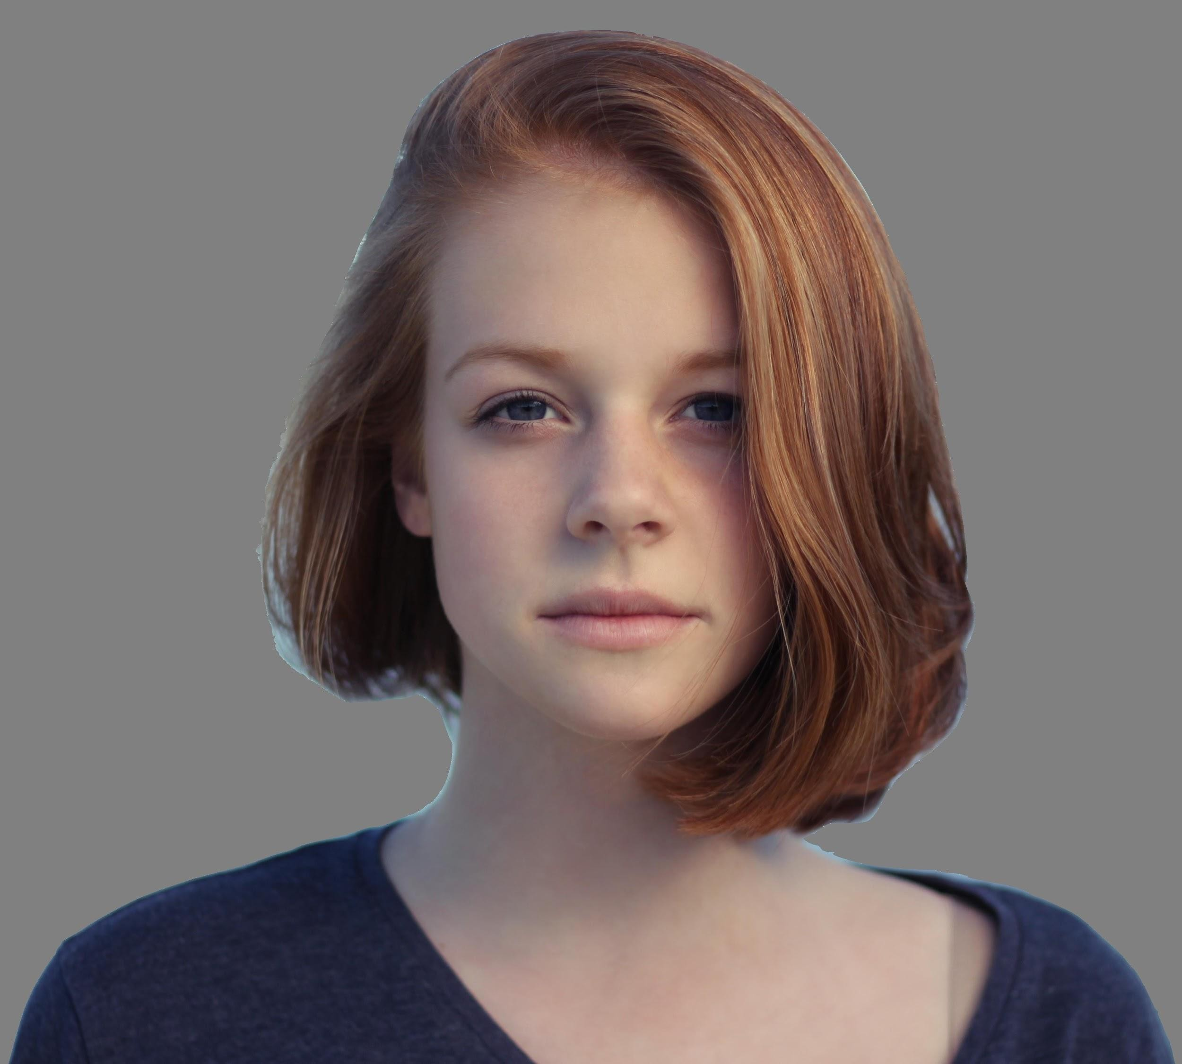
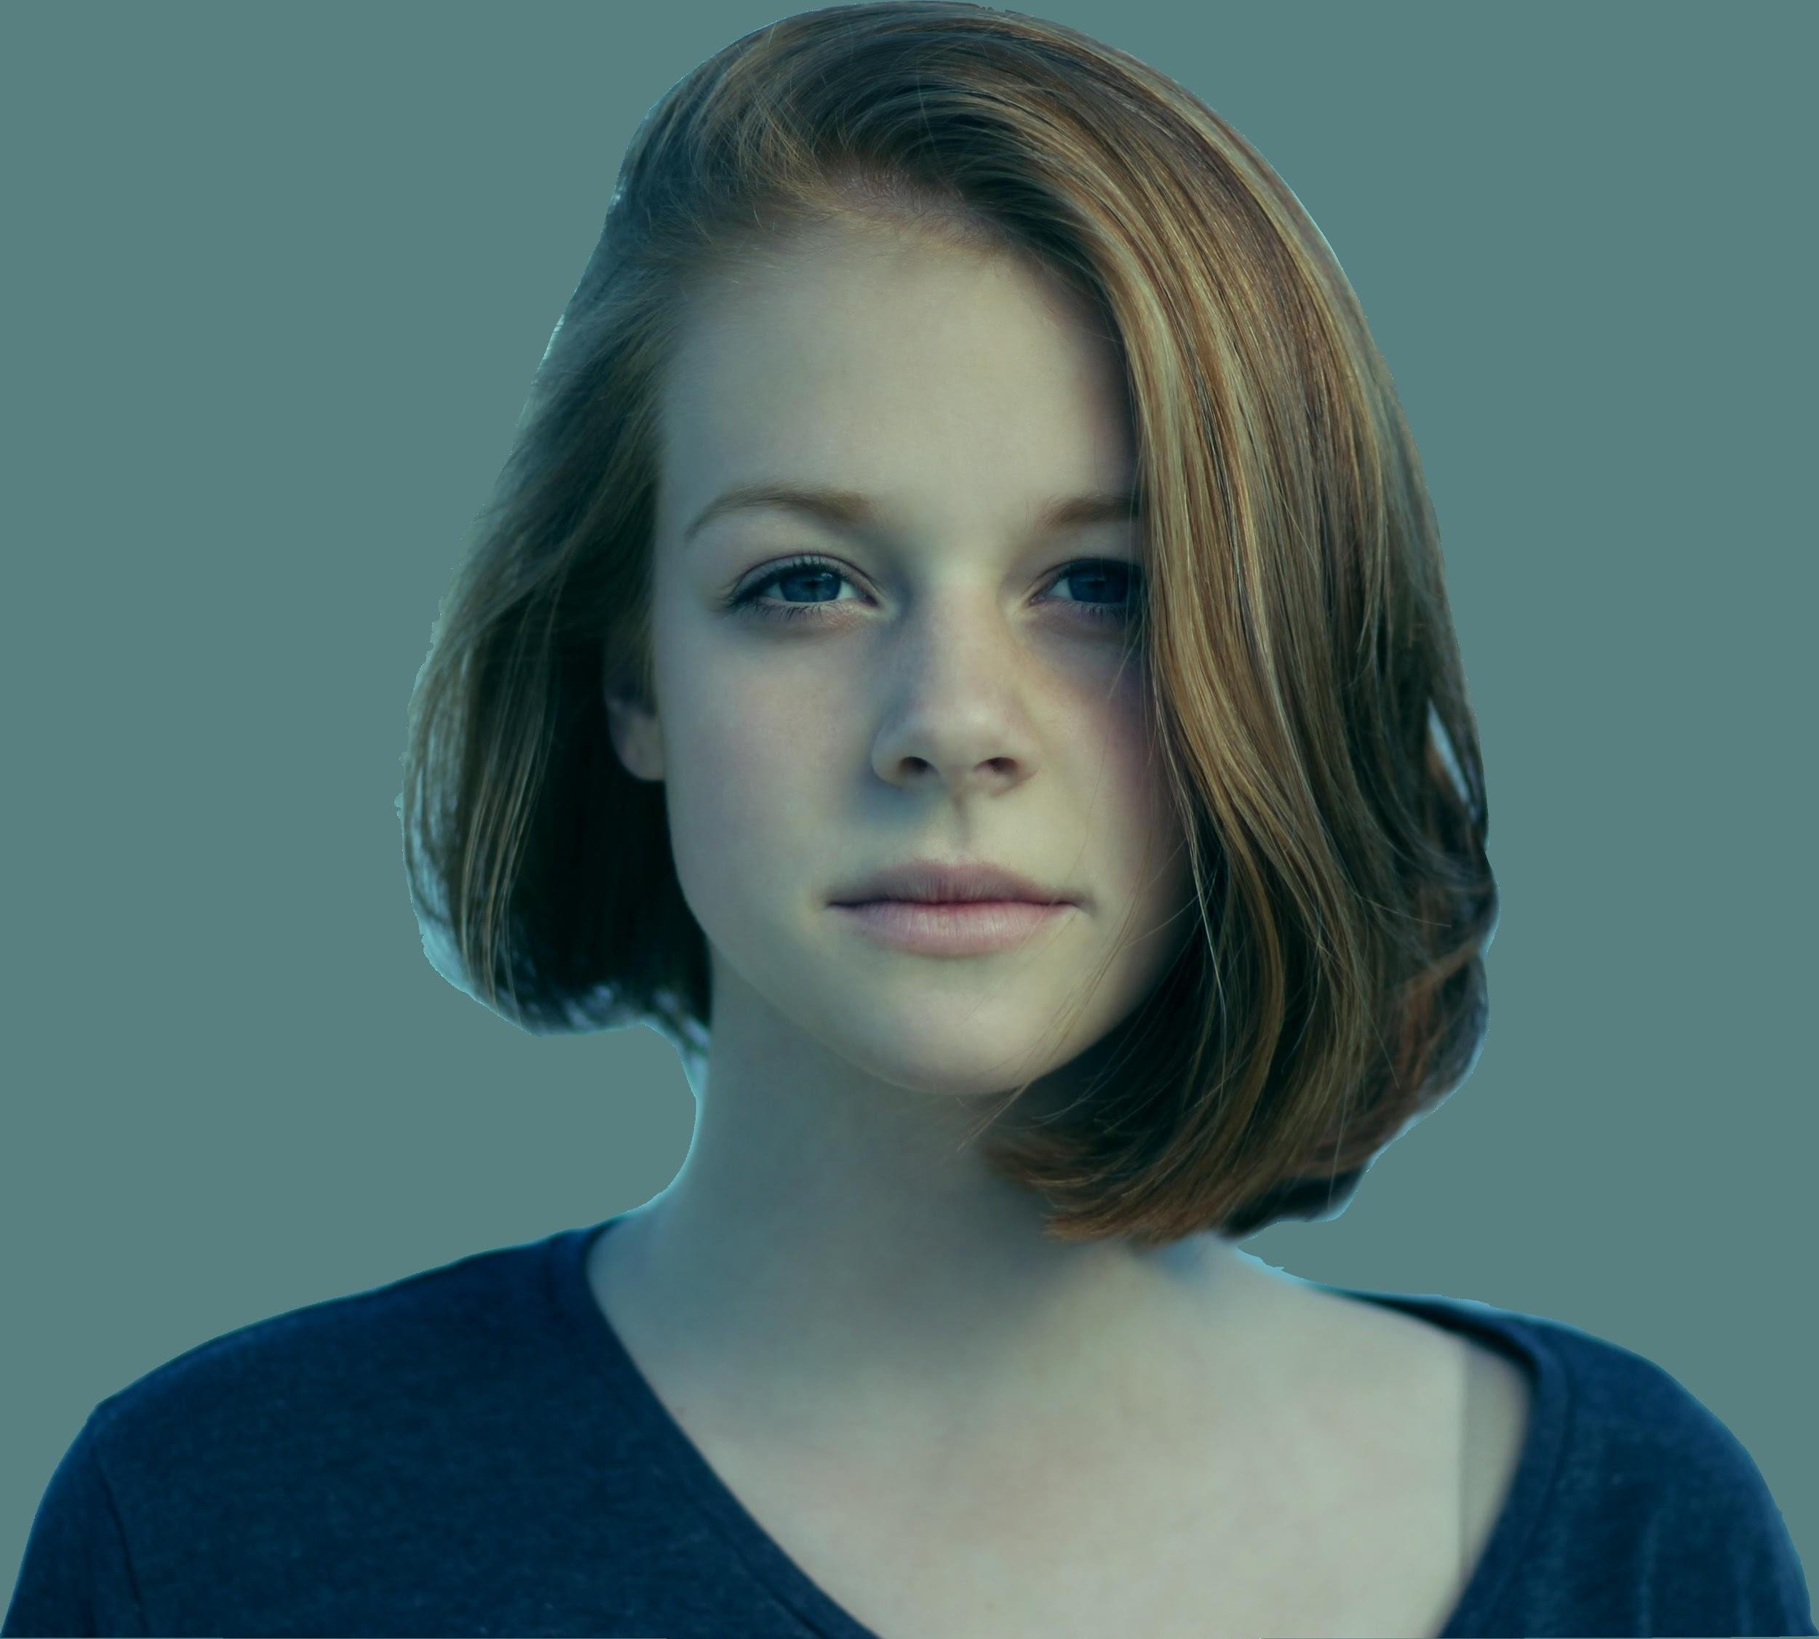
k-Nearest Neighbor on images never used.
k-Nearest Neighbors‘ Drawbacks
Very slow at test time
Distance metrics on pixels are not informative
Original Boxed Shifted
Tinted
Original image is CC0 public domain
(all 3 images have same L2 distance to the one on the left)

Slide 37
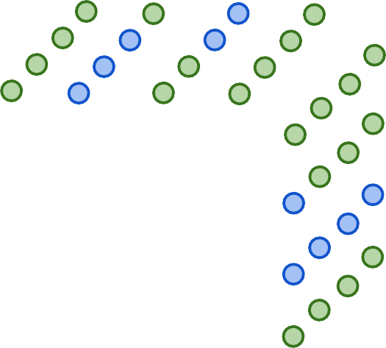


k-Nearest Neighbor on images never used.
Curse of Dimensionalities
- Curse of dimensionality
Dimensions = 3
Points = 4³
Dimensions = 2
Points = 4²
Dimensions = 1
Points = 4
Lecture 2 -

Slide 38
k-Nearest Neighbor: Summary
In Image classification we start with a training set of images and labels, and must predict labels on the test set
The K-Nearest Neighbors classifier predicts labels based on nearest training examples
Distance metric and K are hyperparameters
Choose hyperparameters using the validation set; only run on the test set once at the very end!
Lecture 2 -

Slide 39
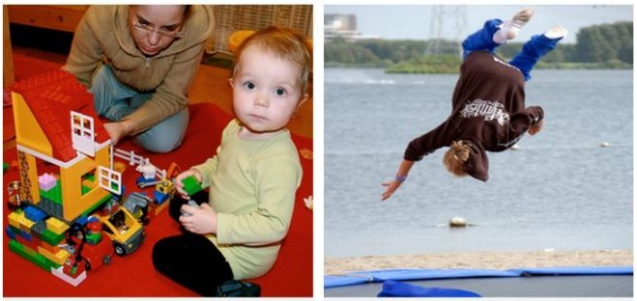
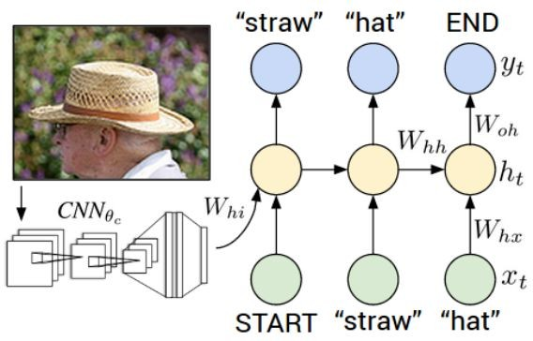
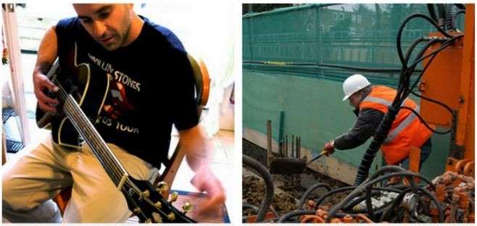
Two young girls are
Linear Classifiers
Boy is doing backflip
on wakeboard
playing with lego toy
Man in black shirt is playing guitar.
Construction worker in orange safety vest is working on road.
Karpathy and Fei-Fei, “Deep Visual-Semantic Alignments for Generating Image Descriptions”, CVPR 2015
Figures copyright IEEE, 2015. Reproduced for educational purposes.
Lecture 2 -

Slide 40
Recall CIFAR10
50,000 training images each image is 32x32x3
10,000 test images.

Slide 41
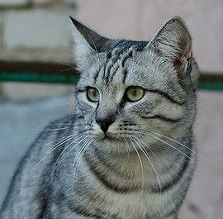
Parametric Approach
Image
f(x,W)
10 numbers giving class scores
Array of 32x32x3 numbers (3072 numbers total)
W
parameters
or weights
Lecture 2 -

Slide 42
f(x,W) = Wx
Parametric Approach: Linear Classifier
Image
f(x,W)
10 numbers giving class scores
Array of 32x32x3 numbers (3072 numbers total)
W
parameters
or weights
Lecture 2 -

Slide 43
Parametric Approach: Linear Classifier
3072x1
f(x,W) = Wx
10x1 10x3072
f(x,W)
Image
10 numbers giving class scores
Array of 32x32x3 numbers (3072 numbers total)
W
parameters
or weights
Lecture 2 -

Slide 44

Image with 4 pixels, and 3 classes (cat/dog/ship)
Classification through a linear classifier
Stretch pixels into column
56
231
24
2
56 | 231
24 | 2
Input image

Slide 45
Image with 4 pixels, and 3 classes (cat/dog/ship)
Classification through a linear classifier
Stretch pixels into column
56
231
24
2
0.2 | -0.5 | 0.1 | 2.0
1.5 | 1.3 | 2.1 | 0.0
0 | 0.25 | 0.2 | -0.3
1.1
3.2
-1.2
-96.8
437.9
61.95
56 | 231
24 | 2
Cat score
+ =
Dog score
Ship score
Input image
W
b
Lecture 2 -

Slide 46
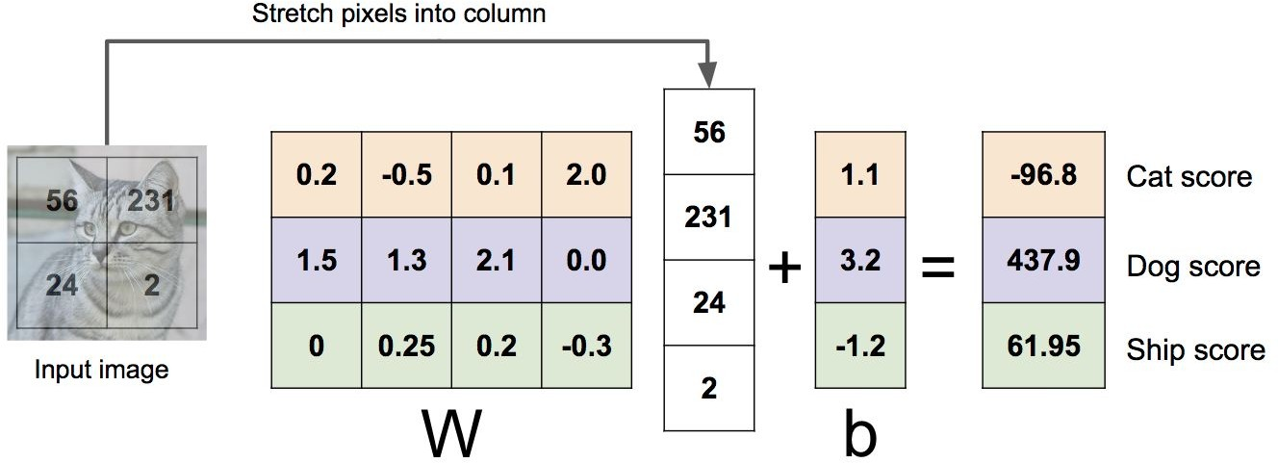
What is a linear Classifier
Image with 4 pixels, and 3 classes (cat/dog/ship)
Algebraic Viewpoint
f(x,W) = Wx
Lecture 2 -

Slide 47
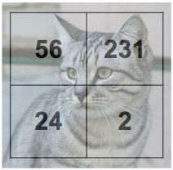
What is a linear Classifier
Image with 4 pixels, and 3 classes (cat/dog/ship)
Input image
W
Algebraic Viewpoint
f(x,W) = Wx
0.2 | -0.5
0.1 | 2.0
1.5 | 1.3
2.1 | 0.0
0 | .25
0.2 | -0.3
b
1.1
3.2
-1.2
Score
-96.8
437.9
61.95
Lecture 2 -

Slide 48
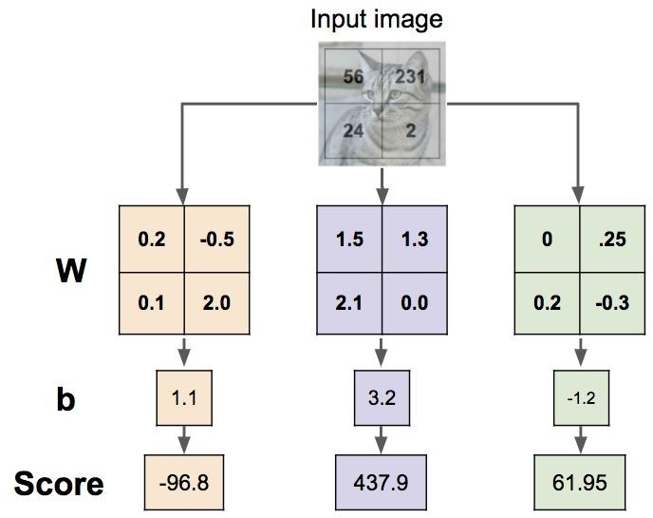
Interpreting a linear Classifier
Lecture 2 -

Slide 49
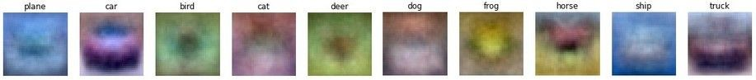
Visual Viewpoint
Interpreting a linear Classifier
Lecture 2 -

Slide 50
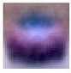
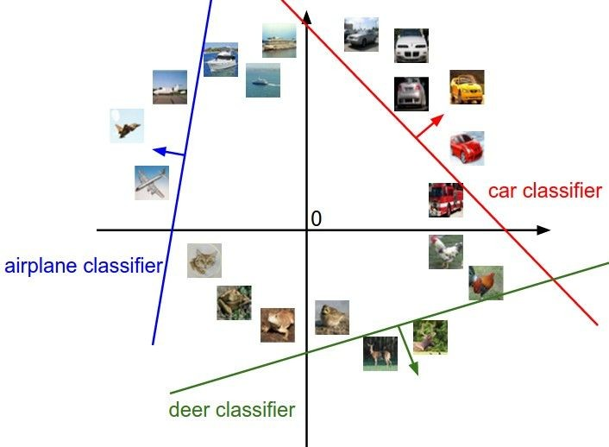
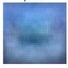
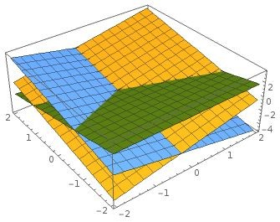
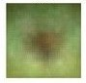
Geometric Viewpoint
Interpreting a linear Classifier
f(x,W) = Wx + b
Array of 32x32x3 numbers (3072 numbers total)
Plot created using Wolfram Cloud
Cat image by Nikita is licensed under CC-BY 2.0
Lecture 2 -

Slide 51
Hard cases for a linear classifier
Class 1:
First and third quadrants
Class 1:
1 <= L2 norm <= 2
Class 1: Three modes
Class 2:
Second and fourth quadrants
Class 2:
Everything Else
Class 2:
Everything Else
Lecture 2 -

Slide 52
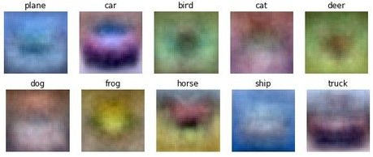
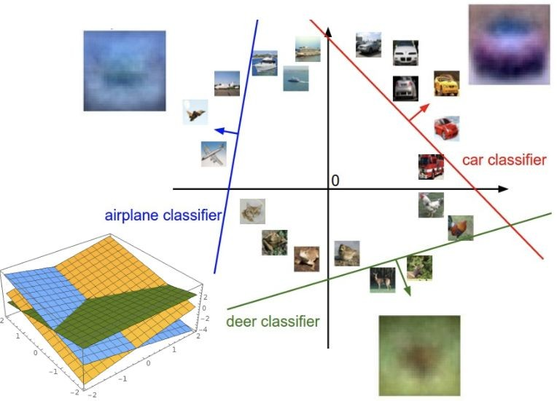
Linear Classifier: Three Viewpoints
Algebraic Viewpoint
Visual Viewpoint
Geometric Viewpoint
f(x,W) = Wx
Hyperplanes cutting up space
One template per class

Slide 53
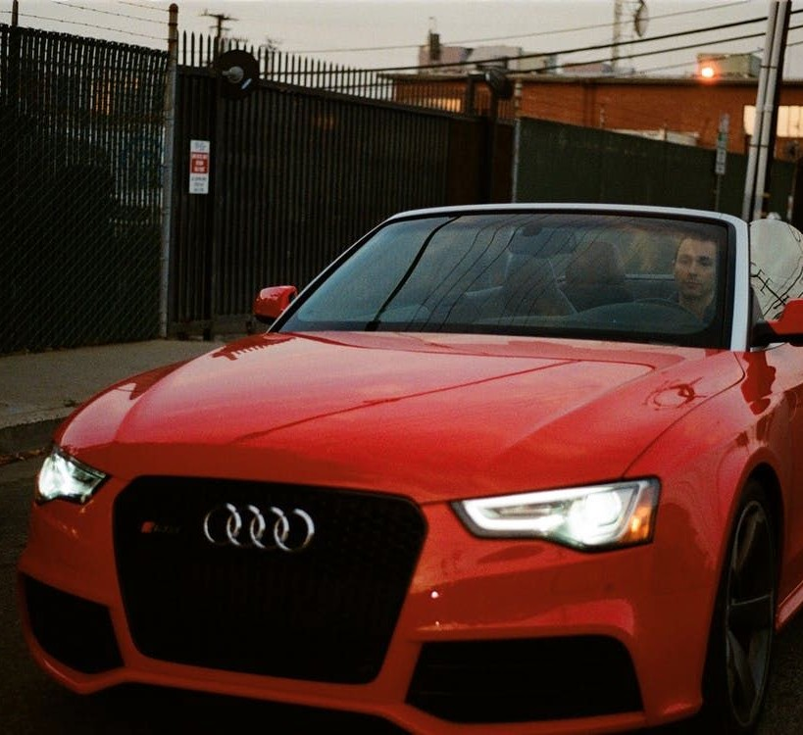
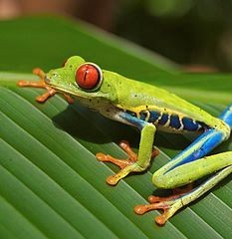
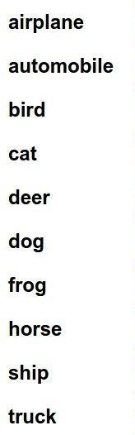
So far: Defined a (linear) score function f(x,W) = Wx + b
Linear Classifier: Three Viewpoints
Example class scores for 3 images for some W:
-3.45
-8.87
0.09
2.9
4.48
8.02
3.78
1.06
-0.36
-0.72
-0.51
6.04
5.31
-4.22
-4.19
3.58
4.49
-4.37
-2.09
-2.93
3.42
4.64
2.65
5.1
2.64
5.55
-4.34
-1.5
-4.79
6.14
How can we tell whether this W is good or bad?
Lecture 2 -
Cat image by Nikita is licensed under CC-BY 2.0 Car image is CC0 1.0 public domain
Frog image is in the public domain

Slide 54
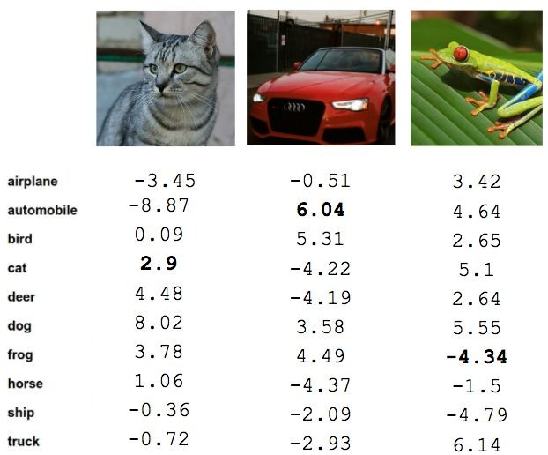
Linear Classifier: TODO List
TODO:
Define a loss function that quantifies our unhappiness with the scores across the training data.
Come up with a way of efficiently finding the parameters that minimize the loss function. (optimization)
Cat image by Nikita is licensed under CC-BY 2.0; Car image is CC0 1.0 public domain; Frog image is in the public domain
Fei-Fei Li & Justin Johnson & Serena Yeung

Slide 55
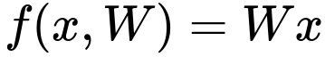
Suppose: 3 training examples, 3 classes. With some W the scores
Linear Classifier: Scores
are:
cat car frog
3.2 | 1.3 | 2.2
5.1 | 4.9 | 2.5
-1.7 | 2.0 | -3.1
Fei-Fei Li & Justin Johnson & Serena Yeung

Slide 56
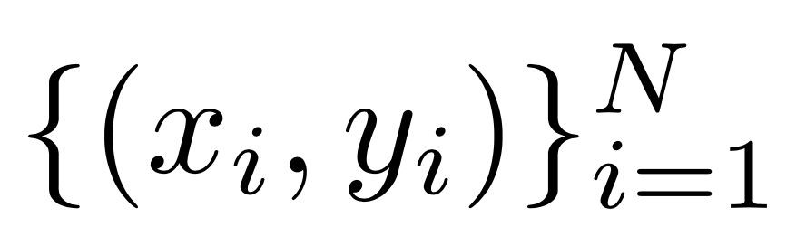
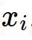
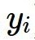
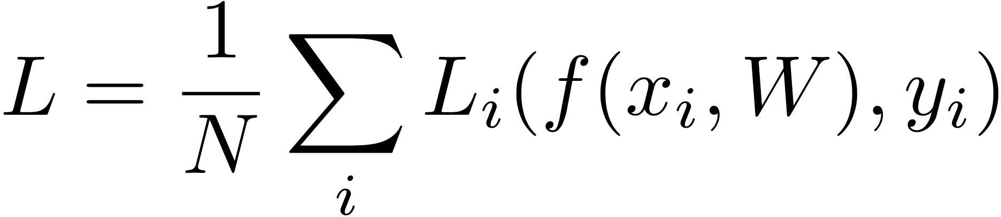
Suppose: 3 training examples, 3 classes. With some W the scores
Loss Functions
A loss function tells how good our current classifier is
are:
Given a dataset of examples
cat car frog
Where
is image and
is (integer) label
3.2 | 1.3 | 2.2
5.1 | 4.9 | 2.5
-1.7 | 2.0 | -3.1
Loss over the dataset is a sum of loss over examples:
Fei-Fei Li & Justin Johnson & Serena Yeung

Slide 57
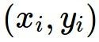
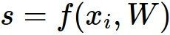

Suppose: 3 training examples, 3 classes. With some W the scores
Multiclass SVM Loss
Multiclass SVM loss:
Given an example
are:
where where
is the image and
is the (integer) label,
and using the shorthand for the scores vector:
cat car frog
the SVM loss has the form:
3.2 | 1.3 | 2.2
5.1 | 4.9 | 2.5
-1.7 | 2.0 | -3.1
Fei-Fei Li & Justin Johnson & Serena Yeung

Slide 58




Suppose: 3 training examples, 3 classes. With some W the scores
Multiclass SVM Loss
Multiclass SVM loss:
are:
“Hinge loss”
Given an example
where is the image and where is the (integer) label,
and using the shorthand for the scores vector:
the SVM loss has the form:
cat car frog
3.2 | 1.3 | 2.2
5.1 | 4.9 | 2.5
-1.7 | 2.0 | -3.1
Fei-Fei Li & Justin Johnson & Serena Yeung

Slide 59

Suppose: 3 training examples, 3 classes. With some W the scores
Multiclass SVM Loss
Multiclass SVM loss:
Given an example
are:
where where
is the image and
is the (integer) label,
and using the shorthand for the scores vector:
cat car frog
the SVM loss has the form:
3.2 | 1.3 | 2.2
5.1 | 4.9 | 2.5
-1.7 | 2.0 | -3.1
Fei-Fei Li & Justin Johnson & Serena Yeung

Slide 60
Multiclass SVM Loss
Suppose: 3 training examples, 3 classes. With some W the scores
Multiclass SVM loss:
Given an example
are:
where where
is the image and
is the (integer) label,
and using the shorthand for the scores vector:
cat car frog
Losses:
3.2
5.1
-1.7
2.9
1.3 2.2
4.9 2.5
2.0 -3.1
the SVM loss has the form:
= max(0, 5.1 - 3.2 + 1)
+max(0, -1.7 - 3.2 + 1)
= max(0, 2.9) + max(0, -3.9)
= 2.9 + 0
= 2.9
Fei-Fei Li & Justin Johnson & Serena Yeung

Slide 61
Multiclass SVM Loss
Suppose: 3 training examples, 3 classes. With some W the scores
Multiclass SVM loss:
Given an example
are:
where where
is the image and
is the (integer) label,
and using the shorthand for the scores vector:
cat car frog
Losses:
3.2
5.1
-1.7
2.9
1.3
4.9
2.0
0
2.2
2.5
-3.1
the SVM loss has the form:
= max(0, 1.3 - 4.9 + 1)
+max(0, 2.0 - 4.9 + 1)
= max(0, -2.6) + max(0, -1.9)
= 0 + 0
= 0
Fei-Fei Li & Justin Johnson & Serena Yeung

Slide 62
Multiclass SVM Loss
Suppose: 3 training examples, 3 classes. With some W the scores
Multiclass SVM loss:
Given an example
are:
where where
is the image and
is the (integer) label,
and using the shorthand for the scores vector:
cat car frog
Losses:
3.2
5.1
-1.7
2.9
1.3
4.9
2.0
0
2.2
2.5
-3.1
12.9
the SVM loss has the form:
= max(0, 2.2 - (-3.1) + 1)
+max(0, 2.5 - (-3.1) + 1)
= max(0, 6.3) + max(0, 6.6)
= 6.3 + 6.6
= 12.9
Fei-Fei Li & Justin Johnson & Serena Yeung

Slide 63

Multiclass SVM Loss
Suppose: 3 training examples, 3 classes. With some W the scores
Multiclass SVM loss:
Given an example
are:
where where
is the image and
is the (integer) label,
and using the shorthand for the scores vector:
cat car frog
Losses:
the SVM loss has the form:
3.2 | 1.3 | 2.2
5.1 | 4.9 | 2.5
-1.7 | 2.0 | -3.1
Loss over full dataset is average:
2.9
0
12.9
L = (2.9 + 0 + 12.9)/3
= 5.27
Fei-Fei Li & Justin Johnson & Serena Yeung

Slide 64
Multiclass SVM Loss
Suppose: 3 training examples, 3 classes. With some W the scores
Multiclass SVM loss:
Given an example
are:
where where
is the image and
is the (integer) label,
and using the shorthand for the scores vector:
cat car frog
Losses:
the SVM loss has the form:
3.2 | 1.3 | 2.2
5.1 | 4.9 | 2.5
-1.7 | 2.0 | -3.1
Q: What happens to loss if car scores change a bit?
2.9
0
12.9
Fei-Fei Li & Justin Johnson & Serena Yeung

Slide 65
Multiclass SVM Loss
Suppose: 3 training examples, 3 classes. With some W the scores
Multiclass SVM loss:
Given an example
are:
where where
is the image and
is the (integer) label,
and using the shorthand for the scores vector:
cat car frog
Losses:
the SVM loss has the form:
3.2 | 1.3 | 2.2
5.1 | 4.9 | 2.5
-1.7 | 2.0 | -3.1
Q2: what is the min/max possible loss?
2.9
0
12.9
Fei-Fei Li & Justin Johnson & Serena Yeung

Slide 66
Multiclass SVM Loss
Suppose: 3 training examples, 3 classes. With some W the scores
Multiclass SVM loss:
Given an example
are:
where where
is the image and
is the (integer) label,
and using the shorthand for the scores vector:
cat car frog
Losses:
the SVM loss has the form:
3.2 | 1.3 | 2.2
5.1 | 4.9 | 2.5
-1.7 | 2.0 | -3.1
Q3: At initialization W is small so all s ≈ 0.
What is the loss?
2.9
0
12.9
Fei-Fei Li & Justin Johnson & Serena Yeung

Slide 67
Multiclass SVM Loss
Suppose: 3 training examples, 3 classes. With some W the scores
Multiclass SVM loss:
Given an example
are:
where where
is the image and
is the (integer) label,
and using the shorthand for the scores vector:
cat car frog
Losses:
the SVM loss has the form:
3.2 | 1.3 | 2.2
5.1 | 4.9 | 2.5
-1.7 | 2.0 | -3.1
Q4: What if the sum was over all classes? (including j = y_i)
2.9
0
12.9
Fei-Fei Li & Justin Johnson & Serena Yeung

Slide 68
Multiclass SVM Loss
Suppose: 3 training examples, 3 classes. With some W the scores
Multiclass SVM loss:
Given an example
are:
where where
is the image and
is the (integer) label,
and using the shorthand for the scores vector:
cat car frog
Losses:
the SVM loss has the form:
3.2 | 1.3 | 2.2
5.1 | 4.9 | 2.5
-1.7 | 2.0 | -3.1
Q5: What if we used mean instead of sum?
2.9
0
12.9
Fei-Fei Li & Justin Johnson & Serena Yeung

Slide 69

Multiclass SVM Loss
Suppose: 3 training examples, 3 classes. With some W the scores
Multiclass SVM loss:
Given an example
are:
where where
is the image and
is the (integer) label,
and using the shorthand for the scores vector:
cat car frog
Losses:
the SVM loss has the form:
3.2 | 1.3 | 2.2
5.1 | 4.9 | 2.5
-1.7 | 2.0 | -3.1
Q6: What if we used
2.9
0
12.9
Fei-Fei Li & Justin Johnson & Serena Yeung

Slide 70

Multiclass SVM Loss - Implementation
Fei-Fei Li & Justin Johnson & Serena Yeung

Slide 71
Multiclass SVM Loss
E.g. Suppose that we found a W such that L = 0. Is this W unique?
Fei-Fei Li & Justin Johnson & Serena Yeung

Slide 72
Multiclass SVM Loss
E.g. Suppose that we found a W such that L = 0. Is this W unique?
No! 2W is also has L = 0!
Fei-Fei Li & Justin Johnson & Serena Yeung

Slide 73
Suppose: 3 training examples, 3 classes. With some W the scores
Multiclass SVM Loss: Parameters Search
are:
Before:
= max(0, 1.3 - 4.9 + 1)
+max(0, 2.0 - 4.9 + 1)
= max(0, -2.6) + max(0, -1.9)
= 0 + 0
= 0
With W twice as large:
= max(0, 2.6 - 9.8 + 1)
+max(0, 4.0 - 9.8 + 1)
= max(0, -6.2) + max(0, -4.8)
= 0 + 0
= 0
cat 3.2 car 5.1 frog -1.7 | 1.3 4.9 2.0 | 2.2 2.5 -3.1
Losses: 2.9 | 0
Fei-Fei Li & Justin Johnson & Serena Yeung

Slide 74

Regularization
Data loss: Model predictions should match training data
Fei-Fei Li & Justin Johnson & Serena Yeung

Slide 75

Regularization
Data loss: Model predictions should match training data
Regularization: Prevent the model from doing too well on training data
Fei-Fei Li & Justin Johnson & Serena Yeung

Slide 76

Regularization
= regularization strength (hyperparameter)
Data loss: Model predictions should match training data
Regularization: Prevent the model from doing too well on training data
Fei-Fei Li & Justin Johnson & Serena Yeung

Slide 77


Regularization
= regularization strength (hyperparameter)
Data loss: Model predictions should match training data
Regularization: Prevent the model from doing too well on training data
Simple examples L2 regularization: L1 regularization:
Elastic net (L1 + L2):
Fei-Fei Li & Justin Johnson & Serena Yeung

Slide 78
Regularization
= regularization strength (hyperparameter)
Data loss: Model predictions should match training data
Regularization: Prevent the model from doing too well on training data
Simple examples L2 regularization: L1 regularization:
Elastic net (L1 + L2):
More complex: Dropout
Batch normalization
Stochastic depth, fractional pooling, etc
Fei-Fei Li & Justin Johnson & Serena Yeung

Slide 79
Regularization
= regularization strength (hyperparameter)
Data loss: Model predictions should match training data
Regularization: Prevent the model from doing too well on training data
Why regularize?
Express preferences over weights
Make the model simple so it works on test data
Improve optimization by adding curvature
Fei-Fei Li & Justin Johnson & Serena Yeung

Slide 80





Regularization - Expressing Preferences
L2 Regularization
Fei-Fei Li & Justin Johnson & Serena Yeung

Slide 81
Regularization - Expressing Preferences
L2 Regularization
L2 regularization likes to “spread out” the weights
Fei-Fei Li & Justin Johnson & Serena Yeung

Slide 82
Regularization – Prefer simpler Models
y
x
Fei-Fei Li & Justin Johnson & Serena Yeung

Slide 83
Regularization – Prefer simpler Models
f₁
f₂
y
x
Fei-Fei Li & Justin Johnson & Serena Yeung

Slide 84
Regularization – Prefer simpler Models
f₁
f₂
y
x
Regularization pushes against fitting the data
too well so we don’t fit noise in the data
Fei-Fei Li & Justin Johnson & Serena Yeung

Slide 85
Softmax Classifier (Multinomial Logistic Regression)
Softmax Classifier
Want to interpret raw classifier scores as probabilities
cat car frog
3.2
5.1
-1.7
Fei-Fei Li & Justin Johnson & Serena Yeung

Slide 86


Softmax Classifier (Multinomial Logistic Regression)
Softmax Classifier
Want to interpret raw classifier scores as probabilities
Softmax Function
cat car frog
3.2
5.1
-1.7
Fei-Fei Li & Justin Johnson & Serena Yeung

Slide 87
Softmax Classifier (Multinomial Logistic Regression)
Softmax Classifier
Want to interpret raw classifier scores as probabilities
Softmax Function
Probabilities must be >= 0
cat car frog
3.2
5.1
-1.7
24.5
164.0
0.18
exp
unnormalized probabilities
Fei-Fei Li & Justin Johnson & Serena Yeung

Slide 88
Softmax Classifier (Multinomial Logistic Regression)
Softmax Classifier
Want to interpret raw classifier scores as probabilities
Softmax Function
Probabilities must be >= 0
Probabilities must sum to 1
cat car frog
3.2
5.1
-1.7
24.5
164.0
0.18
0.13
0.87
0.00
exp
normalize
unnormalized
probabilities
Fei-Fei Li & Justin Johnson & Serena Yeung
probabilities

Slide 89
Softmax Classifier (Multinomial Logistic Regression)
Softmax Classifier
Want to interpret raw classifier scores as probabilities
Softmax Function
Probabilities must be >= 0
Probabilities must sum to 1
cat car frog
3.2
5.1
-1.7
24.5
164.0
0.18
0.13
0.87
0.00
exp
normalize
Unnormalized
unnormalized
probabilities
log-probabilities / logits
probabilities
Fei-Fei Li & Justin Johnson & Serena Yeung

Slide 90

Softmax Classifier (Multinomial Logistic Regression)
Softmax Classifier
Want to interpret raw classifier scores as probabilities
Softmax Function
Probabilities must be >= 0
Probabilities must sum to 1
cat car frog
3.2
5.1
-1.7
24.5
164.0
0.18
0.13
0.87
0.00
L_{i} = -log(0.13)
= 2.04
exp
normalize
Maximum Likelihood Estimation Choose probabilities to maximize the likelihood of the observed data (See CS 229 for details)
Unnormalized
unnormalized
probabilities
log-probabilities / logits
probabilities
Fei-Fei Li & Justin Johnson & Serena Yeung

Slide 91
Softmax Classifier (Multinomial Logistic Regression)
Softmax Classifier
Want to interpret raw classifier scores as probabilities
Softmax Function
Probabilities must be >= 0
Probabilities must sum to 1
cat car frog
3.2 | exp | 24.5 |  | 0.13 | compare | 1.00
5.1 |  | 164.0 | normalize | 0.87 |  | 0.00
-1.7 |  | 0.18 |  | 0.00 |  | 0.00
Unnormalized
unnormalized
probabilities
Correct
log-probabilities / logits
probabilities
probs
April 10, 2018
Fei-Fei Li & Justin Johnson & Serena Yeung

Slide 92


Softmax Classifier (Multinomial Logistic Regression)
Softmax Classifier
Want to interpret raw classifier scores as probabilities
Softmax Function
Probabilities must be >= 0
Probabilities must sum to 1
cat car frog
3.2
5.1
-1.7
24.5
164.0
0.18
0.13
0.87
0.00
compare
1.00
0.00
0.00
exp
normalize
Kullback–Leibler divergence
Unnormalized
log-probabilities / logits
unnormalized probabilities
probabilities
Correct probs
Fei-Fei Li & Justin Johnson & Serena Yeung
Lecture 3 - 51
April 10, 2018

Slide 93


Softmax Classifier (Multinomial Logistic Regression)
Softmax Classifier
Want to interpret raw classifier scores as probabilities
Softmax Function
Probabilities must be >= 0
Probabilities must sum to 1
cat car frog
3.2
5.1
-1.7
24.5
164.0
0.18
0.13
0.87
0.00
compare
1.00
0.00
0.00
exp
normalize
Cross Entropy
Unnormalized
log-probabilities / logits
unnormalized probabilities
probabilities
Correct probs
Fei-Fei Li & Justin Johnson & Serena Yeung

Slide 94





Distance Metric - Intuition
Take L2 (Euclidean) distance in parametric models
Assuming є has Gaussian Distribution:
Rewrite the model in form:
Where
If we apply it to high order polinomia:

Slide 95





Distance Metric - Intuition
Recall the Negative Log Likelihood
We can express the Log Likelihood of the data, as
Inserting the definition of the Gaussian:
RSS is the sum of residual squares,
If we average them,
MSE – Mean Squared Error

Slide 96



Regularization - Intuition
Posterior Distribution,
From prior over weights
and likelihood
Minimize
Also called, Ridge Regression
Penalization: l2 regularization

Slide 97

Softmax Classifier (Multinomial Logistic Regression)
Softmax Classifier
Want to interpret raw classifier scores as probabilities
Softmax Function
Maximize probability of correct class
Putting it all together:
cat car frog
3.2
5.1
-1.7
Fei-Fei Li & Justin Johnson & Serena Yeung

Slide 98
Softmax Classifier (Multinomial Logistic Regression)
Softmax Classifier
Want to interpret raw classifier scores as probabilities
Softmax Function
Maximize probability of correct class
Putting it all together:
cat car frog
3.2
5.1
-1.7
Q: What is the min/max possible loss L_i?
Fei-Fei Li & Justin Johnson & Serena Yeung

Slide 99
Softmax Classifier (Multinomial Logistic Regression)
Softmax Classifier
Want to interpret raw classifier scores as probabilities
Softmax Function
Maximize probability of correct class
Putting it all together:
cat car frog
3.2
5.1
-1.7
Q: What is the min/max possible loss L_i?
A: min 0, max infinity
Fei-Fei Li & Justin Johnson & Serena Yeung

Slide 100
Softmax Classifier (Multinomial Logistic Regression)
Softmax Classifier
Want to interpret raw classifier scores as probabilities
Softmax Function
Maximize probability of correct class
Putting it all together:
cat car frog
3.2
5.1
-1.7
Q2: At initialization all s will be approximately equal; what is the loss?
Fei-Fei Li & Justin Johnson & Serena Yeung

Slide 101
Softmax Classifier (Multinomial Logistic Regression)
Softmax Classifier
Want to interpret raw classifier scores as probabilities
Softmax Function
Maximize probability of correct class
Putting it all together:
cat car frog
3.2
5.1
-1.7
Q2: At initialization all s will be approximately equal; what is the loss? A: log(C), eg log(10) ≈ 2.3
Fei-Fei Li & Justin Johnson & Serena Yeung

Slide 102

Softmax vs. SVM
Fei-Fei Li & Justin Johnson & Serena Yeung

Slide 103
Softmax vs. SVM
Fei-Fei Li & Justin Johnson & Serena Yeung

Slide 104

Softmax vs. SVM
assume scores: [10, -2, 3]
[10, 9, 9]
[10, -100, -100]
and
Q: Suppose I take a datapoint and I jiggle a bit (changing its score slightly). What happens to the loss in both cases?
Fei-Fei Li & Justin Johnson & Serena Yeung

Slide 105



Recap
We have some dataset of (x,y)
We have a score function:
We have a loss function:
e.g.
Softmax
SVM
Full loss
Fei-Fei Li & Justin Johnson & Serena Yeung

Slide 106
How do we find the best W?
Recap
We have some dataset of (x,y)
We have a score function:
We have a loss function:
e.g.
Softmax
SVM
Full loss
Fei-Fei Li & Justin Johnson & Serena Yeung

Slide 107

Motivation example: Kinect

Slide 108



























Image classification example
[MSR Tutorial on decision forests by Criminisi et al, 2011]

Slide 109











Classification tree
[Criminisi et al, 2011]

Slide 110








Another commerce example
Simafore.com

Slide 111

















From a spreadsheet to a decision node
[AI book of Stuart Russell and Peter Norvig]

Slide 112






A learned decision tree
[AI book of Stuart Russell and Peter Norvig]

Slide 113











How do we construct the tree ? i.e., how to pick attribute (nodes)?
For a training set containing p positive examples and n negative examples, we have:
p n p p
n n
H ( , ) = − log
log
p + n p + n
2
2
p + n p + n
p + n p + n

Slide 114





How to pick nodes?
A chosen attribute A, with K distinct values, divides the training set
E into subsets E₁, … , E_{K}.
The Expected Entropy (EH) remaining after trying attribute A
(with branches i=1,2,…,K) is
K
EH ( A) = ∑
p_{i} +n_{i H (} p_{i}
n_{i}
, )
p + n p_{i} + n_{i} p_{i} + n_{i}
i=1
Information gain (I) or reduction in entropy for this attribute is:
p n
I ( A) = H (
, ) − EH ( A)
p + n p + n
Choose the attribute with the largest I
[Hwee Tou Ng & Stuart Russell]

Slide 115
















Example
Convention: For the training set, p = n = 6, H(6/12, 6/12) = 1 bit
Consider the attributes Patrons and Type (and others too):
2 4
I (Patrons) = 1−[ ² H (0,1) + ⁴ H (1,0) + ⁶ H ( , )] = .0541 bits
0
12 12 12 6 6
.
1 1 ₊ 2
1 1 ₊ 4
2 2 ₊ 4 2 2
I (Type) = 1−[ ² H ( , )
H ( , )] = 0 bits 12 2 2 12 2 2 12 4 4 12 4 4
H ( , )
H ( , )
[Hwee Tou Ng & Stuart Russell]

Slide 116










Classification tree
[Criminisi et al, 2011]

Slide 117






Use information gain to decide splits
[Criminisi et al, 2011]

Slide 118



























Building a random tree

Slide 119












Random Forests algorithm
[From the book of Hastie, Friedman and Tibshirani]

Slide 120

Randomization
[Criminisi et al, 2011]

Slide 121

Recall - The Tradeoff of the Out-of-Sample Error
Take Expectation with respect to x, and obtain bias and variance
↓
H ↑
↑
§

Slide 122













Building a forest (ensemble)
[Criminisi et al, 2011]

Slide 123
Sources
http://cs231n.stanford.edu/syllabus.html
https://www.cs.ubc.ca/~nando/340-2012/lectures.php
https://github.com/jonesgithub/book-1/blob/master/ML%20Machine%20Learning-A%20Probabilistic%20Perspective.pdf

